Slide 1
Classification
Naïve Bayesian classification, Decision trees, Decision rules,
Instance-based methods

Slide 2
Supervised vs. Unsupervised Learning
Supervised learning (classification)
Supervision: The training data (observations, measurements, etc.) are accompanied by labels indicating the class of the observations.
New data is classified based on the training set.
Unsupervised learning (clustering)
The class labels of training data is unknown.
Given a set of measurements, observations, etc. with the aim of establishing the existence of classes or clusters in the data.

Slide 3
Prediction Problems: Classification vs. Numeric Prediction
Classification
Predicts categorical class labels (discrete or nominal)
Classifies data (constructs a model) based on the training set and the values (class labels) in a classifying attribute and uses it in classifying new data
Numeric Prediction
Models continuous-valued functions, i.e., predicts unknown or missing values
Typical applications
Credit/loan approval:
Medical diagnosis: if a tumor is cancerous or benign
Fraud detection: if a transaction is fraudulent
Web page categorization: which category it is

Slide 4
Classification
Data classification is a two-step process: Learning & Classification step.
Learning step (or Training phase or Model construction): where a classification model is constructed.
Describing a set of predetermined classes.
“Learning from” a training set made up of database tuples and their associated class labels.
Each tuple/sample is assumed to belong to a predefined class, as determined by the class label attribute.
The set of tuples used for model construction is training set
The model is represented as classification rules, decision trees, or mathematical formulae
The class label attribute is categorical (or nominal) in that each value serves as a category or class.

Slide 5
Classification
Classification step (Model usage ): where the model is used to predict class labels for given data.
Classifying future or unknown objects
If the accuracy is acceptable, use the model to classify new data
Note: If the test set is used to select models, it is called validation (test) set

Slide 6
Classification
Estimate accuracy of the model
The known label of test sample is compared with the classified result from the model
Accuracy rate is the percentage of test set samples that are correctly classified by the model
Test set is independent of training set (otherwise overfitting)

Slide 7
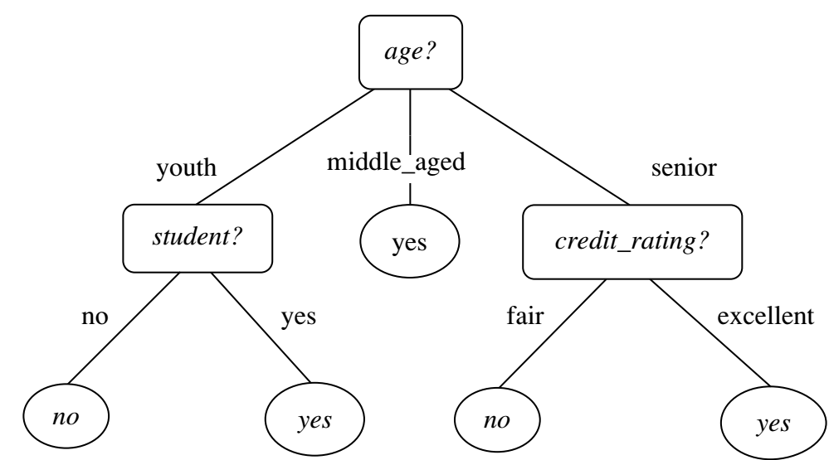
Decision Tree
A decision tree is a flowchart-like tree structure:
Each internal node (nonleaf node) denotes a test on an attribute
Each branch represents an outcome of the test.
Each leaf node (or terminal node) holds a class label.
Internal nodes are denoted by rectangles.
Leaf nodes are denoted by ovals.
Some decision tree algorithms produce only binary trees.
Others can produce nonbinary trees.

Slide 8
Decision Tree
How are decision trees used for classification?
Given a tuple, X, for which the associated class label is unknown, the attribute values of the tuple are tested against the decision tree.
A path is traced from the root to a leaf node, which holds the class prediction for that tuple.
Decision trees can easily be converted to classification rules.
Decision tree classifiers have good accuracy. However, successful use may depend on the data at hand.

Slide 9
Decision Tree
Popular traditional Decision Tree Algorithms:
ID3 (Iterative Dichotomiser)
C4.5 (a successor of ID3)
CART (Classification And Regression Trees)
ID3, C4.5, and CART adopt a greedy (i.e., nonbacktracking) approach in which decision trees are constructed in a top-down recursive divide-and-conquer manner.

Slide 10
Decision Tree
Decision tree algorithm has three parameters:
D: data partition, Initially, it is the complete set of training tuples and their associated class labels.
Parameter attribute list: the set of candidate attributes.
Attribute selection method: specifies a heuristic procedure for selecting the attribute that “best” discriminates the given tuples according to class.
The criterion consists of a splitting attribute and, possibly, either a split-point or splitting subset.
Attribute selection measure such as information gain or the Gini index.
Gini index: Tree is strictly binary
Information gain: Multiway splits (i.e., two or more branches to be grown from a node)

Slide 11
Decision Tree
If the tuples in D are all of the same class, then node N becomes a leaf and is labeled with that class (Stopping criteria).
Otherwise, the algorithm calls Attribute selection method to determine the splitting criterion.
All the tuples in partition D (represented at node N) belong to the same class.
Stopping criteria: Recursive partitioning stops only when any one of the following terminating conditions is true :
All the tuples in partition D (represented at node N) belong to the same class.
There are no remaining attributes on which the tuples may be further partitioned.
There are no tuples for a given branch, that is, a partition D_{j} is empty.

Slide 12
Decision Tree
Let A be the splitting attribute. A has v distinct values, {a₁, a₂,..., a_{v}}, based on the training data.
A is discrete-valued: In this case, the outcomes of the test at node N correspond directly to the known values of A.
A branch is created for each known value, a_{j}, of A and labeled with that value.
A is continuous-valued: In this case, the test at node N has two possible outcomes, corresponding to the conditions A ≤ split point and A > split point, respectively.

Slide 13
Decision Tree: Attribute Selection Measures
Three popular attribute selection measures—
Information gain (ID3)
Gain ratio (C4.5)
Gini index (CART)

Slide 14
Decision Tree: Attribute Selection Measures- Information gain
Information Gain:
ID3 uses information gain as its attribute selection measure.
The attribute with the highest information gain is chosen as the splitting attribute for node N.
To classify the tuples in the resulting partitions and reflects the least randomness or “impurity” in these partitions.

Slide 15
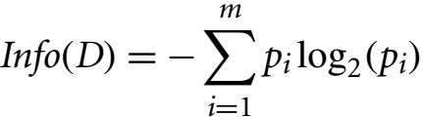
Decision Tree: Attribute Selection Measures- Information gain
Entropy (Information Theory)
A measure of uncertainty associated with a random variable.
High entropy -> higher uncertainty
Lower entropy -> lower uncertainty
The expected information (or entropy) needed to classify a tuple in D is:

Slide 16
Decision Tree: Attribute Selection Measures- Information gain
The expected information (or entropy) needed to classify a tuple in D is:
where p_{i} is the nonzero probability that an arbitrary tuple in D belongs to class C_{i} and is estimated by |C_{i,D}|/|D|.
A log function to the base 2 is used, because the information is encoded in bits.
Info(D) is just the average amount of information needed to identify the class label of a tuple in D.

Slide 17
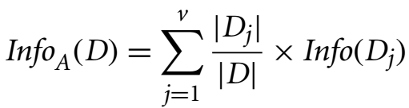

Decision Tree: Attribute Selection Measures- Information gain
Information needed (after using A to split D into v partitions) to classify D:
The term acts as the weight of the j^{th} partition.
Info_{A}(D) is the expected information required to classify a tuple from D based on the partitioning by A.
The smaller the expected information (still) required, the greater the purity of the partitions.

Slide 18

Decision Tree: Attribute Selection Measures- Information gain
Information gain is defined as the difference between the original information requirement (i.e., based on just the proportion of classes) and the new requirement (i.e., obtained after partitioning on A).
Information gained by branching on attribute A

Slide 19
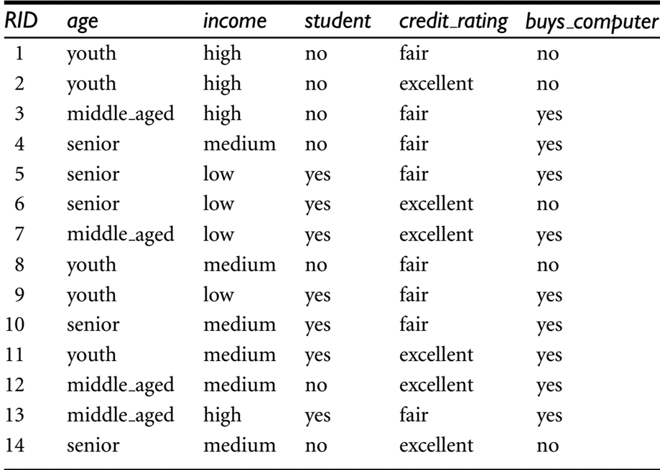
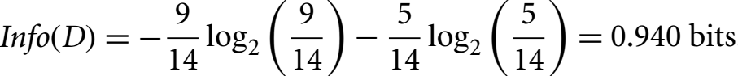
Decision Tree: Attribute Selection Measures- Information gain
In this example, class label attribute, buys_computer, has two distinct values (namely, yes, no).
There are nine tuples of class yes and five tuples of class no.
A (root) node N is created for the tuples in D.
To find the splitting criterion for these tuples, we first need to compute the expected information to classify a tuple in D.

Slide 20
Decision Tree: Attribute Selection Measures- Information gain
Next, we need to compute the expected information requirement for each attribute.
Let’s start with the attribute age. We need to look at the distribution of yes and no tuples for each category of age.

Slide 21
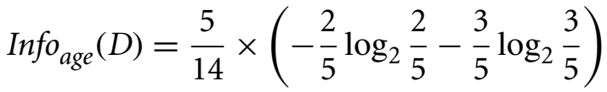
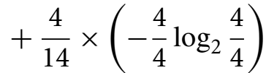
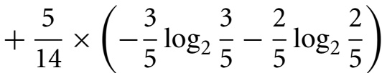

Decision Tree: Attribute Selection Measures- Information gain
For the age category “youth,” there are two yes tuples and three no tuples.
For the category “middle aged,” there are four yes tuples and zero no tuples.
For the category “senior,” there are three yes tuples and two no tuples.

Slide 22
Decision Tree: Attribute Selection Measures- Information gain
Similarly, we can compute Gain(income) =0.029 bits, Gain(student) = 0.151 bits, and Gain(credit_rating) = 0.048 bits.
Because age has the highest information gain among the attributes, it is selected as the splitting attribute.

Slide 23
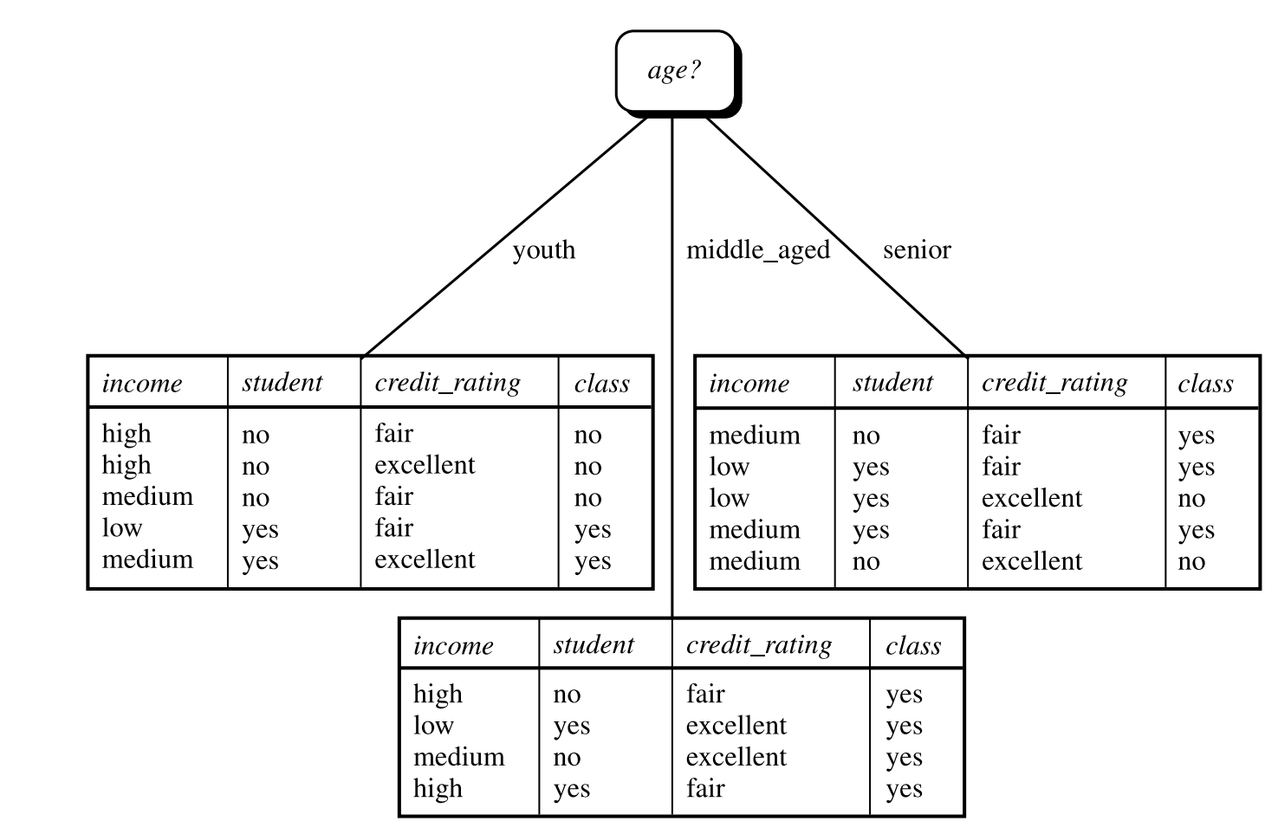
Decision Tree: Attribute Selection Measures- Information gain
*Note the tuples falling into the partition for age D middle aged all belong to the same class.
Therefore be created at the end of this branch and labeled “yes.”

Slide 24
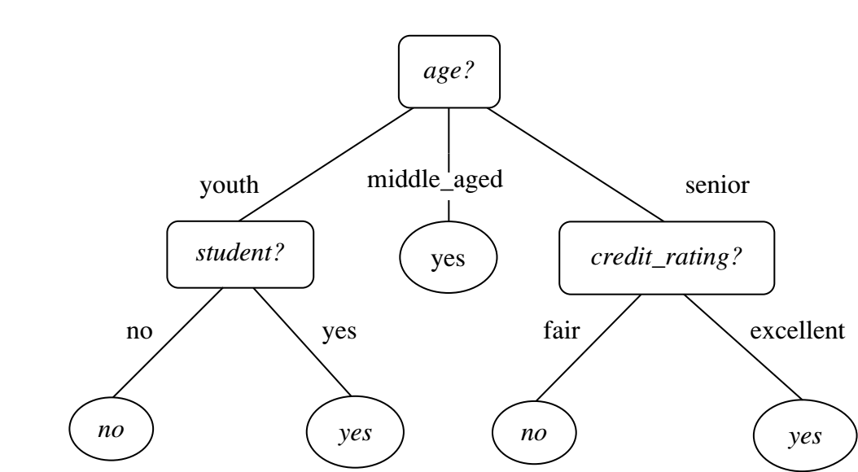
Decision Tree: Attribute Selection Measures- Information gain

Slide 25
Decision Tree: Attribute Selection Measures
Computing Information-Gain for Continuous-Valued Attributes:
Let attribute A be a continuous-valued attribute
Must determine the best split point for A
Sort the value A in increasing order
Typically, the midpoint between each pair of adjacent values is considered as a possible split point
(a_{i}+a_{i+1})/2 is the midpoint between the values of a_{i} and a_{i+1}
The point with the minimum expected information requirement for A is selected as the split-point for A
Split:
D1 is the set of tuples in D satisfying A ≤ split-point, and D2 is the set of tuples in D satisfying A > split-point

Slide 26
Decision Tree: Attribute Selection Measures- Gain Ratio
Information gain measure is biased toward tests with many outcomes.
Information gain prefers to select attributes having a large number of values.
For example, consider an attribute that acts as a unique identifier such as product ID.
A split on product ID would result in a large number of partitions (as many as there are values), each one containing just one tuple.
Each partition is pure, the information required to classify data set D based on this partitioning would be Info_{product_ID}(D)= 0.
Therefore, the information gained by partitioning on this attribute is maximal.

Slide 27
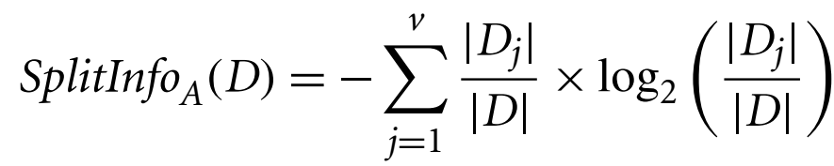
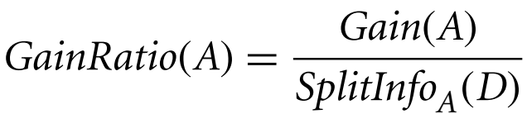
Decision Tree: Attribute Selection Measures- Gain Ratio
C4.5, a successor of ID3, uses an extension to information gain known as gain ratio, which attempts to overcome this bias.
For each outcome, it considers the number of tuples having that outcome with respect to the total number of tuples in D.
The attribute with the maximum gain ratio is selected as the splitting attribute.

Slide 28

Decision Tree: Attribute Selection Measures- Gain Ratio
Computation of gain ratio for the attribute income.
We have Gain(income) = 0.029.
Therefore,
GainRatio(income) 0.029/1.557
= 0.019.

Slide 29
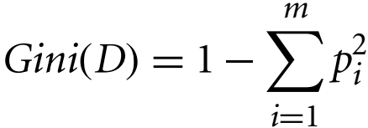
Decision Tree: Attribute Selection Measures- Gini Index
Gini index measures the impurity of a data partition or set of training tuples.
where p_{i} is the probability that a tuple in D belongs to class C_{i} and is estimated by |C_{i,D}|/|D|. The sum is computed over m classes.
Gini index considers a binary split for each attribute.
To determine the best binary split on A, we examine all the possible subsets that can be formed using known values of A.
For example, if income has three possible values, namely {low, medium, high}, then the possible subsets are {low, medium, high}, {low, medium}, {low, high}, {medium, high}, {low}, {medium}, {high}, and {}.

Slide 30
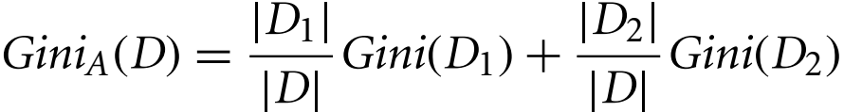
Decision Tree: Attribute Selection Measures- Gini Index
We exclude the power set, {low, medium, high}, and the empty set {} from consideration since, conceptually, they do not represent a split.
Therefore, there are 2^{v} − 2 possible ways to form two partitions of the data D, based on a binary split on A.
When considering a binary split, we compute a weighted sum of the impurity of each resulting partition.
For example, if a binary split on A partitions D into D₁ and D₂, the Gini index of D given that partitioning is:
For a discrete-valued attribute, the subset that gives the minimum Gini index for that attribute is selected as its splitting subset.

Slide 31
Decision Tree: Attribute Selection Measures- Gini Index
The reduction in impurity that would be incurred by a binary split on a discrete- or continuous-valued attribute A is:
The attribute that maximizes the reduction in impurity (or, equivalently, has the minimum Gini index) is selected as the splitting attribute.

Slide 32
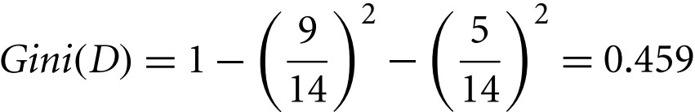
Decision Tree: Attribute Selection Measures- Gini Index
Gini index to compute the impurity of D:
To find the splitting criterion for the tuples in D, we need to compute the Gini index for each attribute.
For attribute income and consider each of the possible splitting subsets.
The subset {low, medium} in 10 tuples in partition D₁ satisfying the condition “income ∈ {low, medium}.”
The remaining four tuples of D would be assigned to partition D₂.

Slide 33

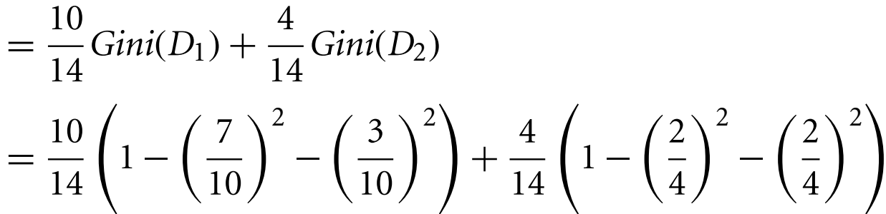


Decision Tree: Attribute Selection Measures- Gini Index
Gini index value computed based on partitioning {low, medium} is
Gini index for the subsets {low, high} and {medium} is 0.458
{medium, high} and {low}= 0.450.
The best binary split for attribute income is on {low, medium*} (or {high}) because it minimizes the Gini index.

Slide 34
Decision Tree: Attribute Selection Measures- Gini Index
Evaluating age, we obtain {youth, senior} (or {middle aged}) as the best split for age with a Gini index of 0.375.
The attributes student and credit_rating are both binary, with Gini index values of 0.367 and 0.429, respectively.
Gini index for the subsets {low, high} and {medium} is 0.458
{medium, high} and {low}= 0.450

Slide 35
Decision Tree
The three measures, in general, return good results but
Information gain:
biased towards multivalued attributes
Gain ratio:
tends to prefer unbalanced splits in which one partition is much smaller than the others
Gini index:
biased to multivalued attributes
has difficulty when # of classes is large
tends to favor tests that result in equal-sized partitions and purity in both partitions

Slide 36
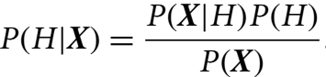
Bayes Classification
Bayesian classifiers are statistical classifiers.
Bayesian classifier can predict class membership probabilities such as the probability that a given tuple belongs to a particular class.
Bayesian classification is based on Bayes’ theorem.
A simple Bayesian classifier known as the naïve Bayesian classifier.
Naïve Bayesian classifiers assume that the effect of an attribute value on a given class is independent of the values of the other attributes.
Bayes’ theorem is useful in that it provides a way of calculating the posterior probability, P(H|X) from P(H), P(X|H), and P(X).

Slide 37
Bayes Classification
For example, X is a 35-year-old customer with an income of $40,000. Suppose that H is the hypothesis that our customer will buy a computer.
Then P(H|X) reflects the probability that customer X will buy a computer given that we know the customer’s age and income.

Slide 38
Bayes Classification
Naïve Bayesian classifiers assume that the effect of an attribute value on a given class is independent of the values of the other attributes.
For example, X is a 35-year-old customer with an income of $40,000. Suppose that H is the hypothesis that our customer will buy a computer.
Then P(H|X) reflects the probability that customer X will buy a computer given that we know the customer’s age and income.

Slide 39
Naïve Bayesian Classification
Naïve Bayesian classifier, or simple Bayesian classifier, works as follows:
Let D be a training set of tuples and their associated class labels. As usual, each tuple is represented by an n-dimensional attribute vector, X = (x₁, x₂,…, x_{n}), depicting n measurements made on the tuple from n attributes, respectively, A₁, A₂,…, A_{n}.
Suppose that there are m classes, C1, C2,:::, Cm. Given a tuple, X, the classifier will predict that X belongs to the class having the highest posterior probability, conditioned on X. That is, the na¨ıve Bayesian classifier predicts that tuple X belongs to the class Ci if and only if

Slide 40
Summary
Data sets are made up of data objects. A data object represents an entity. Data objects are described by attributes. Attributes can be nominal, binary, ordinal, or numeric.
The values of a nominal (or categorical) attribute are symbols or names of things, where each value represents some kind of category, code, or state.
Binary attributes are nominal attributes with only two possible states (such as 1 and 0 or true and false). If the two states are equally important, the attribute is symmetric; otherwise it is asymmetric.
An ordinal attribute is an attribute with possible values that have a meaningful order or ranking among them, but the magnitude between successive values is not known.

Slide 41
References
Jiawei Han, Micheline Kamber and Jian Pei, Data Mining: Concepts and Techniques, Morgan Kaufmann, 3rd Edition.
Tan, Pang-Ning, Michael Steinbach, and Vipin Kumar, Introduction to data mining, Pearson India.

